Slide 1
C++ Presentation on Constructors and Destructors

Slide 2
Constructors
What is the use of Constructor ?
The main use of constructors is to initialize objects.
The function of initialization is automatically carried out by the use of a special member
function called a constructor.

Slide 3
General Syntax of Constructor
Constructor is a special member function that
takes the same name as the class name.
The syntax generally is as given below:
<class name> { arguments};
The default constructor for a class X has the form X::X()

Slide 4
Cont……
The constructor is automatically called when an object is created.
There are several forms in which a constructor can take its shape namely:
Default Constructor
Parameterized Constructors
Copy constructor

Slide 5
Default Constructor:
This constructor has no arguments in it.
Default Constructor is also called as no argument constructor.
Example: class creature
{
private:
int yearofBirth; public:

Slide 6
Cont…..
creature()
{
cout<<“Contructor
}
called";
};
int main()
{
creature obj; getch(); return 0;
}

Slide 7
Parameterized Constructors:
A parameterized constructor is just one that has parameters specified in it.
We can pass the arguments to constructor function when object are created.
A constructor that can take arguments are called
parameterized constructors.

Slide 8
Example:
class Creature { private:
int yearOfBirth; public:
// …
Creature(int year) { yearOfBirth = year;
}
};
//Parameterized Constructor

Slide 9
Copy Constructor:
Copy Constructor is used to declare and initialize an object from another object.
For example the statement: abc c2(c1);
would define the object c2 and at the same time initialize it to the value of c1.
The process of initializing through a copy constructor is known as copy initialization.

Slide 10
Example:
class abc
{
int a, b; public:
abc(int x, int y)
{
a = x;
b = y;
}
abc::abc(abc &p)
{
a = p.a;
b = p.b;
}

Slide 11
Cont……
void showdata()
{
cout << a << " " << b << endl;
}
};
int main()
{
abc c1(10, 20); abc c2(c1); c1.showdata(); c2.showdata(); getch();
}

Slide 12
Default Arguments
Default argument is an argument to a function programmer is not required to specify.
that a
C++ allow the programmer to specify default arguments that always have a value, even if one is not specified when calling the function.
For example, in the following function declaration: int MyFunc(int a, int b, int c=12);

Slide 13
Cont……
The programmer may call this function in two ways:
result = MyFunc(1, 2, 3); result = MyFunc(1, 2);
In the first case the value for the argument called c is specified as normal. In the second one, the argument is omitted, and the default value of 12 will be used instead.
It is possible to define constructors with default arguments.

Slide 14
Some important points about constructors:
Automatically called when an object is created.
We can define our own constructors
A constructor takes the same name as the class name.
We can’t define a constructor in the private section.

Slide 15
Cont…..
No return type is specified for a constructor.
Constructor must be defined in the public. The constructor must be a public member.
Overloading of constructors is possible.
If an object is copied from another object then the copy constructor is called.

Slide 16
Destructors
Destructors are special member functions.
Release dynamic allocated memory.
Destructors are automatically named.
Takes the same name of class name.
General Syntax of Destructors
~ classname(){}

Slide 17
Some important points about destructors:
Take the same name as class name.
Defined in the public.
Destructors cannot be overloaded.
No return type is specified.

Slide 18
Example:
class creature
{
private:
int yearofBirth;
public:
creature()
{
yearofBirth=1970;
cout<<"constructure called"<<endl;
}
~creature()
{
cout<<"destructure called"<<endl;
}
};

Slide 19
Cont……
int main()
{
cout<<"main start"<<endl;
{
creature obj;
}
cout<<"main end"<<endl; getch();
return 0;
}

Slide 20
FOUR PILLARS OF OOPS
Encapsulation
Abstraction
Inheritance
Polymorphism
Conclusion

Slide 21
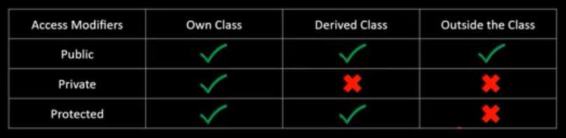
Encapsulation
Encapsulation is a process of binding or wrapping the data and the codes that operates on the data into a single entity. This keeps the data safe from outside interface and misuse. One way to think about encapsulation is as a protective wrapper that prevents code and data from being arbitrarily accessed by other code defined outside the wrapper.
“The ultimate aim of encapsulation is to hide ‘sensitive’ data from user.”

Slide 22
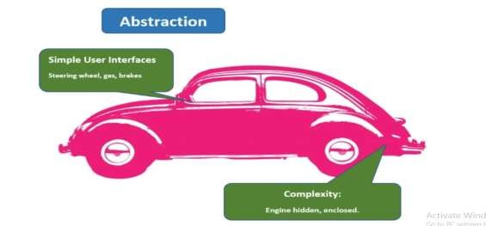





2.Abstraction
Using simple things to represent complexity
Hide complex details from user
Abstraction is using simple classes to represent complexity.Abstraction is an extension of encapsulation. For example, you don’t have to know all the details of how the engine works to drive a car.
A driver only uses a small selection of tools: like gas pedal, brake, steering wheel, blinker. The engineering is hidden from the driver. To make a car work, a lot of pieces have to work under the hood, but exposing that information to the driver would be a dangerous distraction.
Abstraction also serves an important security role. By only displaying selected pieces of data, and only allowing data to be accessed through classes and modified through methods, we protect the data from exposure. To continue with the car example, you wouldn’t want an open gas tank while driving a car.

Slide 23
3.Inheritance
Inheritance is a mechanism in which one class acquires the property of another class.
Reusability is an important concept of OOPs.
Boost the Maintainablity of the code.
The class from which the new class inherits properties is called BASE CLASS and the new created class is called DERIVED CLASS.
Syntax - class derived-class: access-specifier base-class{
// data members and member functions of derived class
}

Slide 24
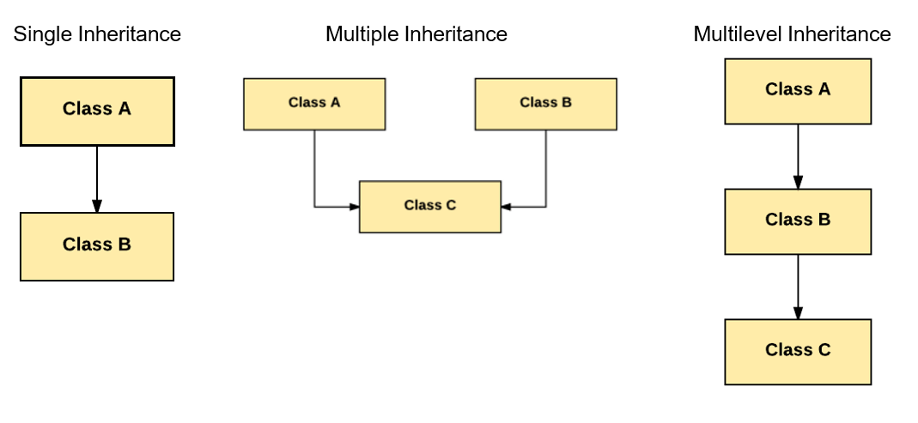
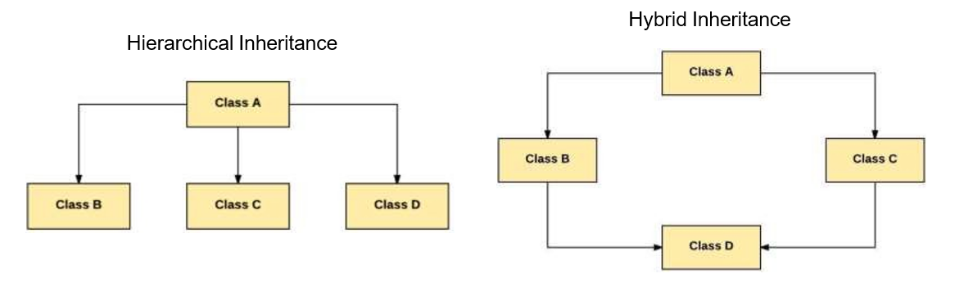
Types of Inheritance

Slide 25
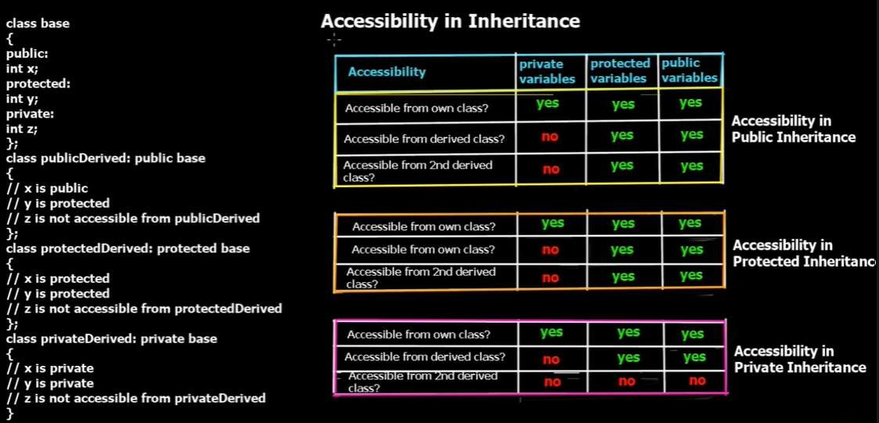

Slide 26
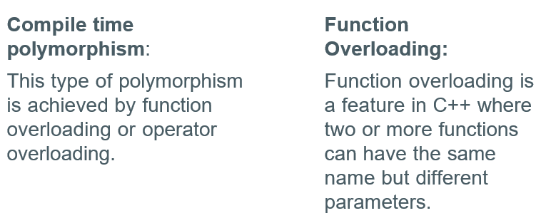
4.Polymorphism
Polymorphism means "the condition of occurring in several different forms." That's exactly what the fourth and final pillar is concerned with – types in the same inheritance chains being able to do different things.
The word polymorphism means having many forms. In simple words, we can define polymorphism as the ability of a message to be displayed in more than one form.
Types:

Slide 27
THANKS

